Slide 1

An Intelligent Search Engine Function
03
Discover how Natural Language Processing (NLP) can revolutionize search engines by improving accuracy and relevance. Learn about Python libraries, NLP Technique, and algorithms used in implementation.
By Md Mahbubur Rahman (拉曼)
Student Id.: 3820231103

Slide 2
Overview of Document Search Engine
Purpose
NLP and NLU
Algorithm Analysis
Understand the goal of the presentation and learn about the functionalities of a document search engine.
Discover how NLP & NLU techniques can enhance search accuracy and improve the overall efficiency of the search engine.
Explore the benefits of leveraging Python for developing a document search engine with NLP capabilities.

Slide 3
Purpose
1. Search Engine
2. Intelligent
3. Intelligent Search Engine
An intelligent search engine enhances the search experience
Personalizing Results: user preferences, location, and past interactions.
Understanding NL: Ask questions in a conversational way, reducing the need for specific keywords.
Learning and Adapting: continuously improves results through machine learning, adjusting to user preferences.
Grasping Word Meanings: words and phrases, finding information.
A search engine is a tool that assists users in finding information on the internet. Users input queries, usually consisting of keywords or questions. The search engine scans its database of web content to find pages related to the query. It then displays a list of results with links to web pages that match the user's query.
Intelligence in the context of search typically refers to the ability of a search system to go beyond simple keyword matching and apply advanced techniques to understand and provide more contextually relevant search results.
For Instances:- Understand Context, Interpret Natural Language, Learn and Improve, Provide Richer Results.

Slide 4
Intelligent Search Engine Approach
Keyword Search
Semantic Search
A traditional search engine is like an intelligent librarian for the internet.
You Ask a Question: For example, you might ask, "How to bake a chocolate cake?"
It Looks for Words: It tries to find pages that have the same words you mentioned, like "bake," "chocolate," and "cake."
It Shows You Results: After searching, it gives you a list of web pages that have those words. These are the pages that might have the information you're looking for.
Semantic search means understanding the intent behind the query and representing the “knowledge in a way suitable for meaningful retrieval,”
“Semantic Search” can simplify query building, because it is supported by automated natural language processing programs i.e. using Latent Semantic Indexing — a concept that search engines use to discover how a keyword and content work together to mean the same thing.
NLP and NLU make semantic search more intelligent through tasks like normalization, typo tolerance, and entity recognition.

Slide 5
Goal : Find The Keywords
An Example of dataset item
Id: 2200000, Author: Frank Manola, Mark F. Hornick, Alejandro P. Buchmann, Title: Object Data Model Facilities for Multimedia Data Types, Venue: GTE Laboratories Incorporated TM-0332-11-90-165, Month: December, Year: 1990, Url: db/journals/gtelab/index.html#TM-0332-11-90-165
Search Example:
I want Object Data model Structures for/ Multimedia Data Typese by Frank Manola in 1990
I want Object Data model Structures for/ Multimedia Data Typese by Frank Manola in 1990
Object Data model, Multimedia Data Type, Frank Manola, 1990
Understanding User Queries:
1
Query Analysis
2
User Query Preprocessing
Examine user queries to extract key information and understand their intent, allowing for precise search results.
Applied NLP techniques like tokenization and word lemmatization to preprocess user queries for better search accuracy.

Slide 6
Intelligent Search Engine Technique
NLP (Natural Language Processing)
NLU (Natural Language Understanding)
NLP is a field in artificial intelligence that deals with how computers and humans interact with language. It includes various language-related tasks.
NLP is one of those things that has built up such a large meaning that it’s easy to look past the fact that it tells you exactly what it is: NLP processes natural language, specifically into a format that computers can understand.
These kinds of processing can include tasks like normalization, spelling correction, or stemming, each of which we’ll look at in more detail.
NLU is a subset of NLP that focuses on enabling machines to deeply understand human language, allowing them to extract meaning and context from text or speech.
NLU, on the other hand, aims to “understand” what a block of natural language is communicating.
It performs tasks that can, for example, identify verbs and nouns in sentences or important items within a text. People or programs can then use this information to complete other tasks.
Notes:
Keyword: : searching over billions of web pages to retrieve and share information. humans are very good at conversational context and background knowledge… search engines, especially when it comes to out-of-the-vocabulary searches?
Semantic: Answer to this problem is semantic search. Using the latest insights from NLP research, it is possible to train a Language Model on a large corpus of documents. Afterwards, the model is able represent documents based on their “semantic” content.

Slide 7

NLP and NLU techniques
NLP Techniques:
Tokenization: Breaking text into individual words or tokens for analysis.
Part-of-Speech Tagging: Labeling words in a sentence with their grammatical roles (e.g., noun, verb, adjective).
Named Entity Recognition (NER): Identifying and categorizing named entities like names, locations, and dates in text.
Language Modeling: Creating statistical models to predict and generate human-like text.
Stemming And Lemmatization: Stemming and lemmatization take different forms of tokens and break them down for comparison.
Plurals: Normalization of plurals to their singular form. For Examples:- “Potato", "deer”, “oxen”, and “mice.” (Machine learning)
Notes:
Often stemming means removing prefixes or suffixes, as in this case.
stemming algorithms:- “carry” and “carries,” --according to the Porter Stemming Algorithm, is “carri.”. The stems for “say,” “says,” and “saying” are all “say,” while the lemmas from Wordnet are “say,” “say,” and “saying.”

Slide 8
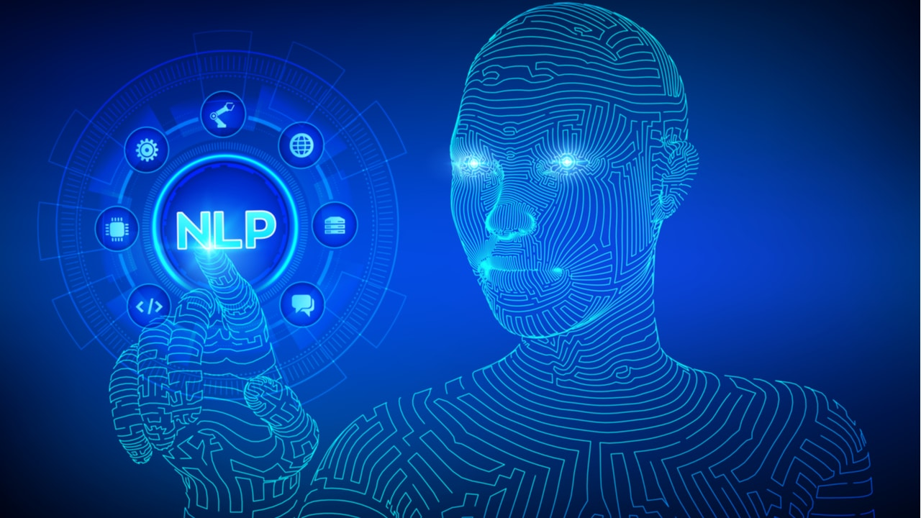
NLP and NLU techniques
NLU Techniques:
Intent Recognition: Identifying the user's intent or purpose behind a text or speech input.
Sentiment Analysis: Determining the emotional tone or sentiment expressed in text (e.g., positive, negative, or neutral).
Context Analysis: Understanding the context of a conversation to provide relevant responses.
Semantic Parsing: Transforming natural language queries into structured representations that computers can understand.
Machine Learning: Using algorithms to train models for tasks such as text classification, question answering, and language translation.
Typo Tolerance And Spell Check: The searcher thinks a word is spelled differently than it is. such as in comparing “scream” and “cream.” (Damerau-Levenshtein Distance algorithm)
Notes:
Typo Tolerance And Spell Check: Sometimes, there are typos because fingers slip and hit the wrong key. Other times, the searcher thinks a word is spelled differently than it is. such as in comparing “scream” and “cream.”
NLP deals with a wide range of language-related tasks, while NLU specifically focuses on enabling machines to deeply understand and extract meaning from human language.

Slide 9
Improving Search Result Relevance
1
TF-IDF Algorithm
2
Cosine Similarity
TF-IDF (Term Frequency-Inverse Document Frequency) is a technique used in semantic search to determine the importance of words or phrases in a collection of documents. It calculates the frequency of terms within a document (TF) and their rarity across the entire document set (IDF). In semantic search, TF-IDF can be extended to consider phrases and combinations of words, helping to capture the meaning of longer expressions. It enhances search results by ranking documents based on their relevance to the query, with those containing important terms or phrases receiving higher scores.
Cosine Similarity is a mathematical measure in semantic search that evaluates how similar two documents are based on their content. It calculates the cosine of the angle between vectors representing the documents in a high-dimensional space. Smaller angles indicate higher similarity, while larger angles suggest dissimilarity. When applied to semantic search, it's used to rank documents based on their similarity to a user's query. Advanced semantic techniques can be added to improve its effectiveness in understanding the meaning and context of words and phrases.

Slide 10
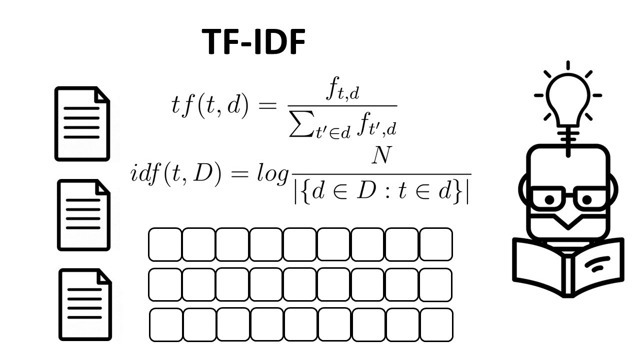
TF-IDF Algorithm Analysis
Where to use TF-IDF? How is TF-IDF used?
There are three main applications for TF-IDF. These are in machine learning, information retrieval, and text summarization/keyword extraction.
Using TF-IDF in information retrieval.
Using TF-IDF in text summarization & keyword extraction.
Vectors & Word Embeddings: TF-IDF, Word2Vec, Bag-of-words, BERT.

Slide 11
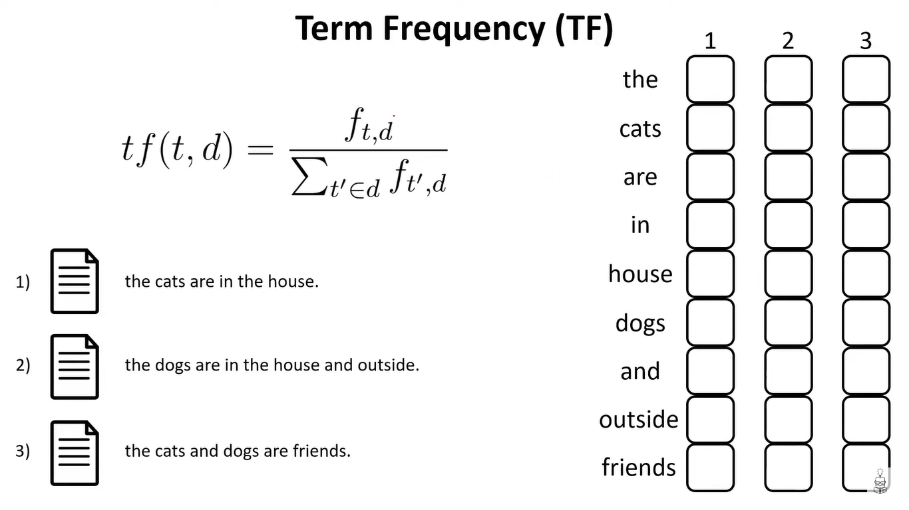
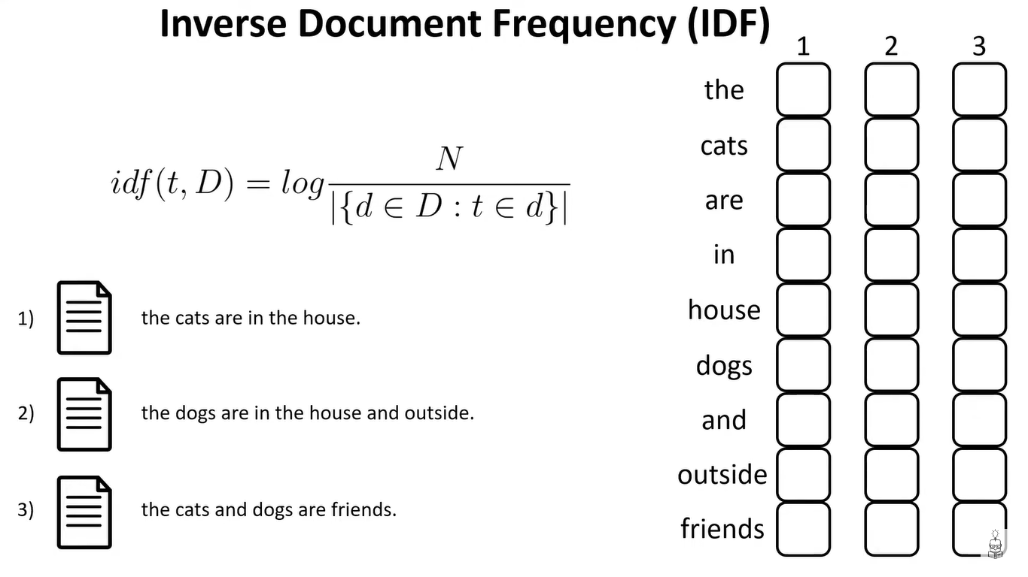
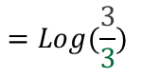
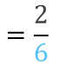
TF-IDF Algorithm Analysis
0.33
0
$$=\frac{2}{6}$$
$$=Log(\frac{3}{3})$$
Notes:
Term in the document “the” appears twice/All the particles of this document such as 6
Inverse : Log ( number of documents 3 / How often “the” affair in all documents 3

Slide 12
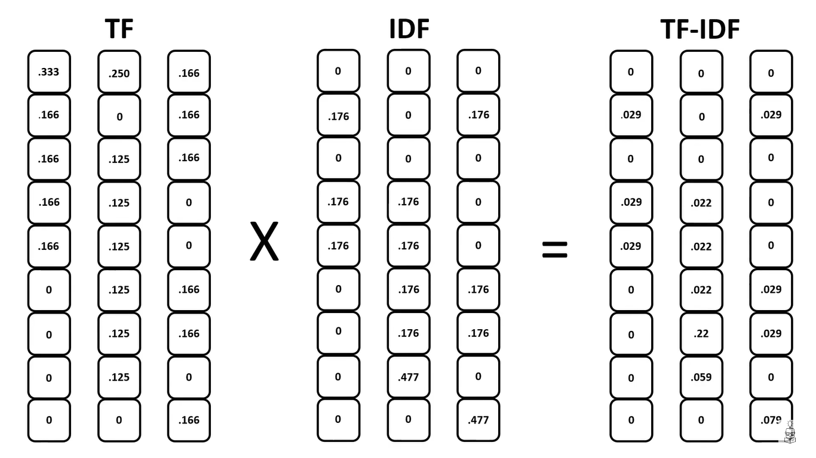
TF-IDF Algorithm Analysis

Slide 13
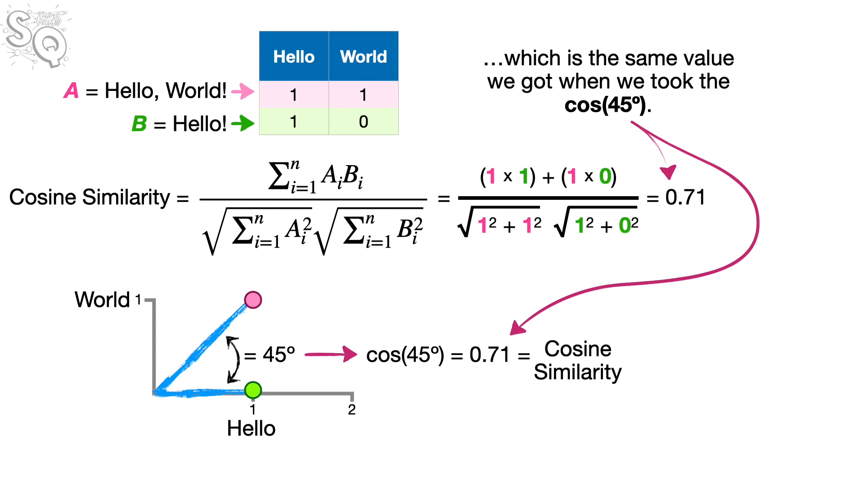
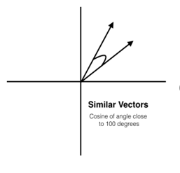
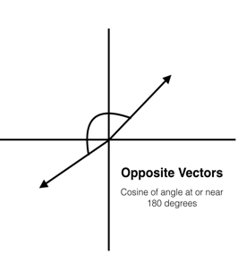
Cosine similarity

Slide 14
Understand Python Libraries for NLP
NLTK
SpaCy
SK Learn
It provides easy-to-use interfaces to over 50 corpora and lexical resources such as WordNet, along with a suite of text processing libraries for classification, tokenization, stemming, tagging, parsing, and semantic reasoning, wrappers, etc.
It excels in tasks like tokenization, part-of-speech tagging, named entity recognition, and dependency parsing. SpaCy is known for its speed, ease of use, and customizable models, making it a top choice for NLP tasks and research. Contextual spell correction.
We can calculating TF-IDF and cosine similarity in the Scikit-Learn library by TfidfVectorizer class to compute TF-IDF for text data and the cosine similarity function to calculate the cosine similarity between vectors, including TF-IDF representations.
Numpy, Pandas, Python Re

Slide 15
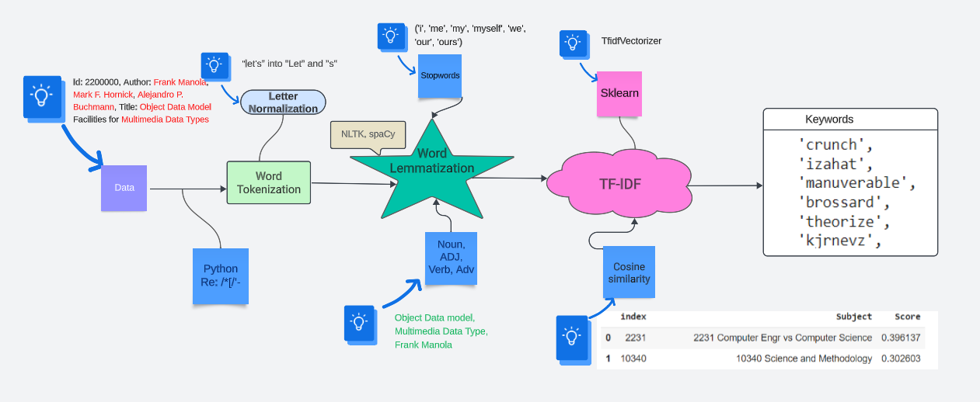
Workflow of This Part

